Slide 1
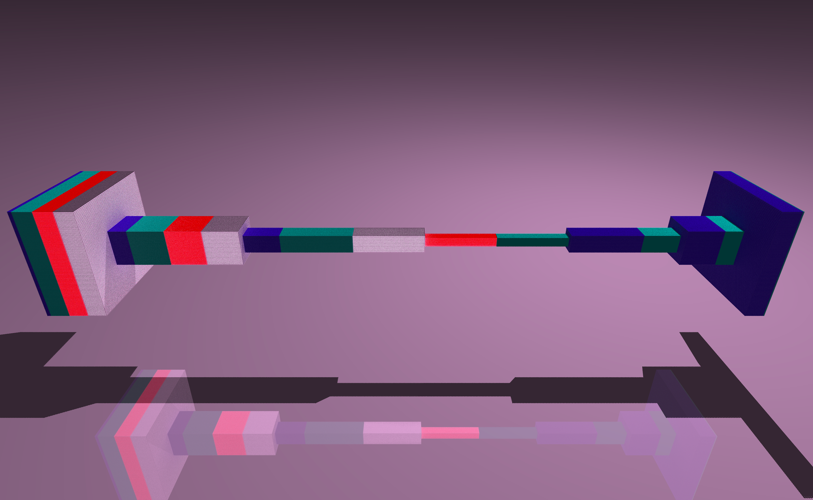

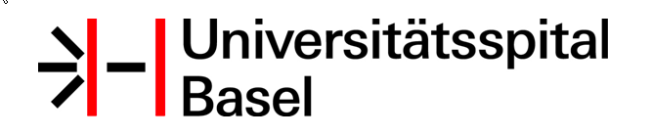
Improving Reading of T2 MRIs through Deep Learning
K Mader (4Quant, Zurich, Switzerland)
B Stieltjes, E Merkle (Unispital Basel, Switzerland)
K Peng (Sun Yat Sun Cancer Center, Guangzhou, China)
RSNA 2016
Wed Nov 30 2016

Slide 2
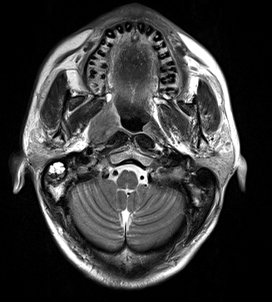
Nasopharyngeal Cancer is a widespread disease and is particularly prevalent in south-east Asia.
Early detection plays a crucial role in successful outcomes.
A number of different options with varying levels of side-effects are available, both staging and grading are critical for optimizing patient care.
Nasopharyngeal Cancer

Slide 3
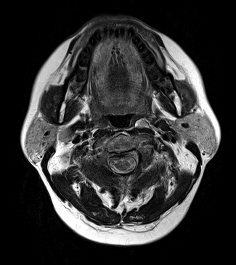
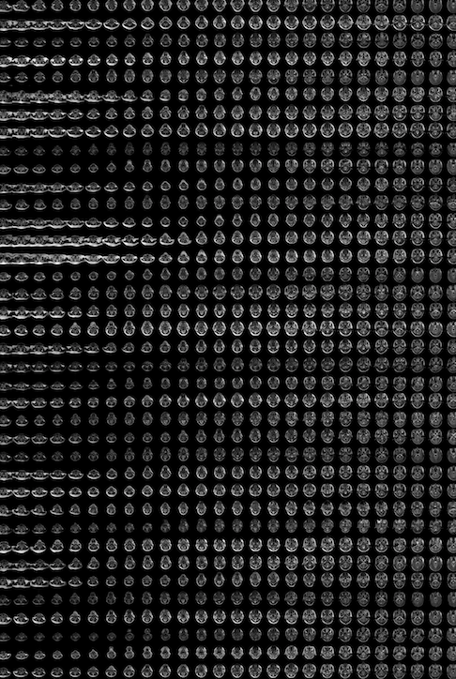
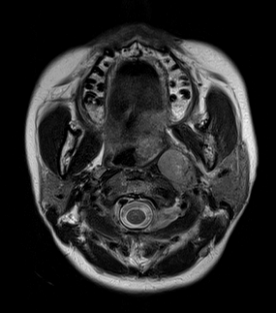
This task is challenging, time-consuming and often very unreliable with standard approaches.
Detecting / Staging Cancer

Slide 4
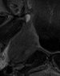
The standard features like texture, shape are generally poor indicators of lesions.
Every tumor case can look very different
There are huge variations in the population.
Standard CADx / Computer Vision
Healthy
Tumor

Slide 5
Why can YOU solve this problem?
Years of experience / Thousands of cases
Relative positions and sizes
-> Context

Slide 6
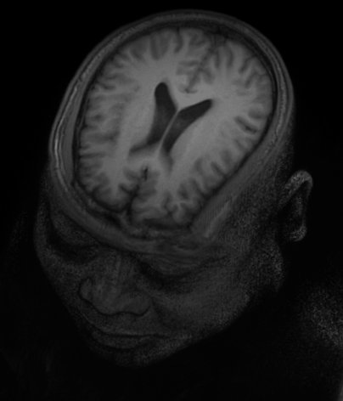
Building a Model
Goal Find tumors/predict outcomes
Input 12’000 Images from Head MRIs
Notes:
How does this work for radiology?
We took a number of different diseases and prepared cases for the computer to learn
Nasopharyngeal Cancer - 200 patients with diagnosis and outcomes
COPD - 800 patients with diagnosis

Slide 7
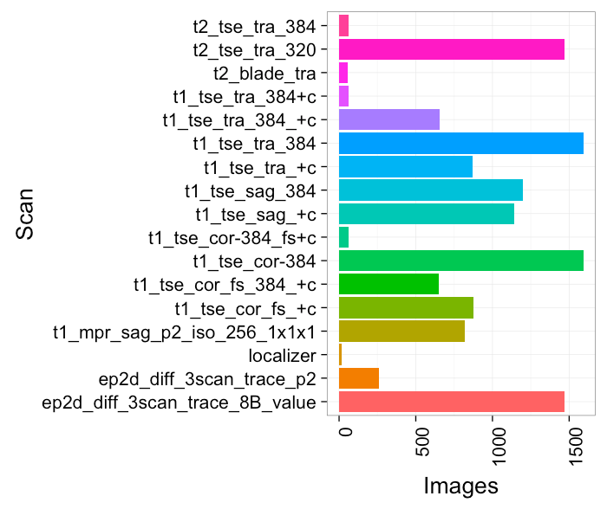
What is the data: very heterogeneous
http://www.thebestoncologist.com/pictures/Lung_cancer_staging.jpg
Notes:
Und schreibt einen befund mit tnm

Slide 8
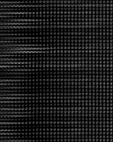
A huge amount of data, thousands of images
The problem is organizing it to extract meaningful information
We can use the DICOM headers, but they are not always reliable since they many involve human inputs (contrast, machine type, settings)
Overwhelmed with data and no context
Notes:
Und schreibt einen befund mit tnm

Slide 9
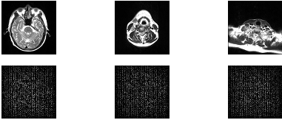
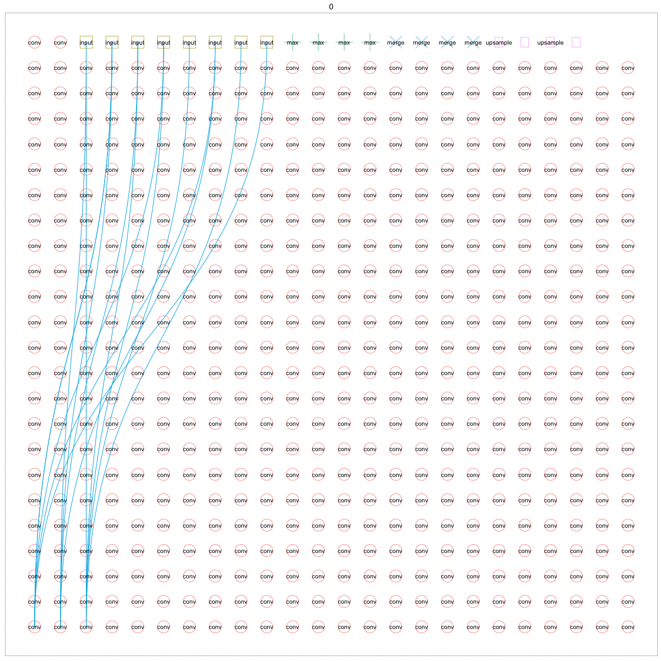
A Neural Network is a powerful approach for dealing with large diverse datasets
Deep Learning is training neural networks with thousands even millions of different neurons spread across dozens of different layers.
These layers allow the network to create representations / abstractions of the problem it is solving and incorporate many different types of information
A perfect challenge for Deep Learning
Notes:
Und schreibt einen befund mit tnm

Slide 10
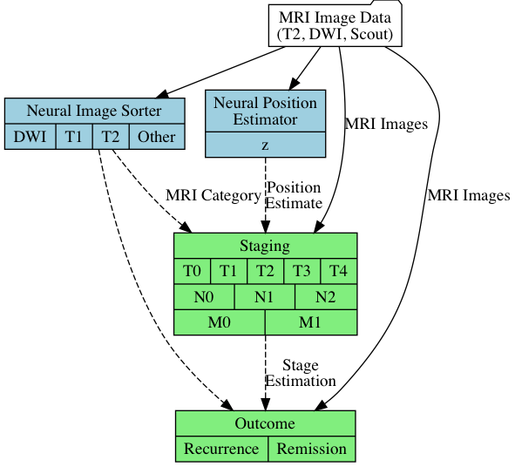
The analysis starts with the MRI and is then preprocessed through two different networks to add context
Neural Image Sorter
Creates an estimate of the type of image being input
Neural Position Estimator
Estimates the position of the image inside the patient frame (z)
Analysis Approach

Slide 11
The outputs of the first networks are then combined with the original data to be processed in the subsequent networks
The Staging network
Outputs a T, N, M stage based on the input given
Outcome Network
Outputs recurrence / remission
Analysis Approach

Slide 12
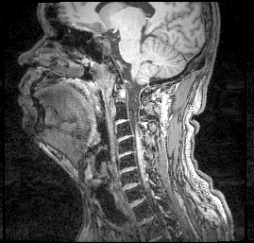
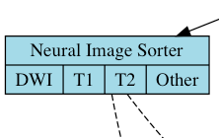
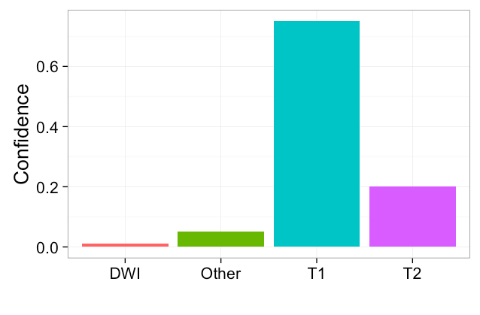
20 layer neural network
InfoGAN structure to learn to latent space for different imaging modalities
The primary categorial outputs are for imaging type
Additional categories are provided for contrast and orientation but these are less reliable channels
Neural Image Sorter
Notes:
Und schreibt einen befund mit tnm

Slide 13
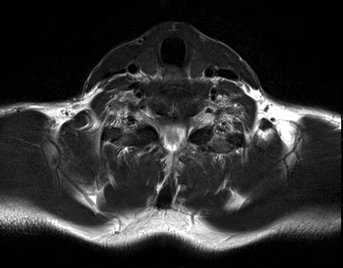
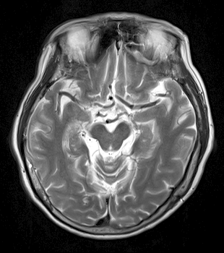
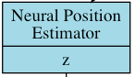
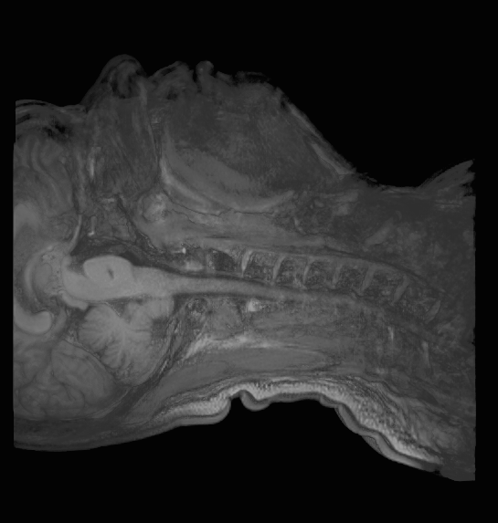
20 layer neural network
Trained as an InfoGAN structure to learn to identify position in the body
The primary output is a continuous estimation of the position (z) along the patient axis
Neural Position Estimator
z
Notes:
Und schreibt einen befund mit tnm

Slide 14
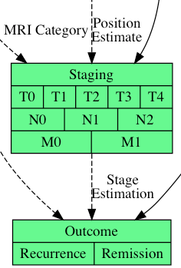
To calculate a staging the inputs of the two previous networks are taken and combined with the original image data
For recurrence the staging network is included
The setup allows for training piecemeal or ‘end-to-end’
Staging and Outcome

Slide 15
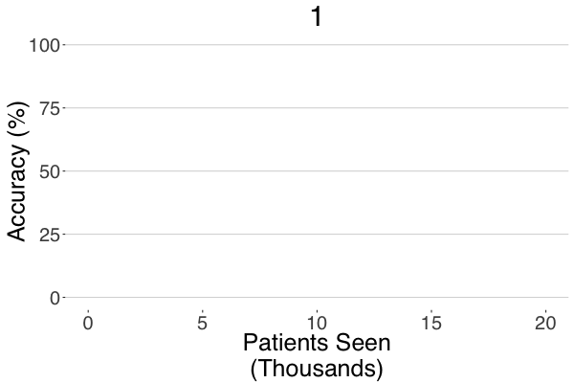
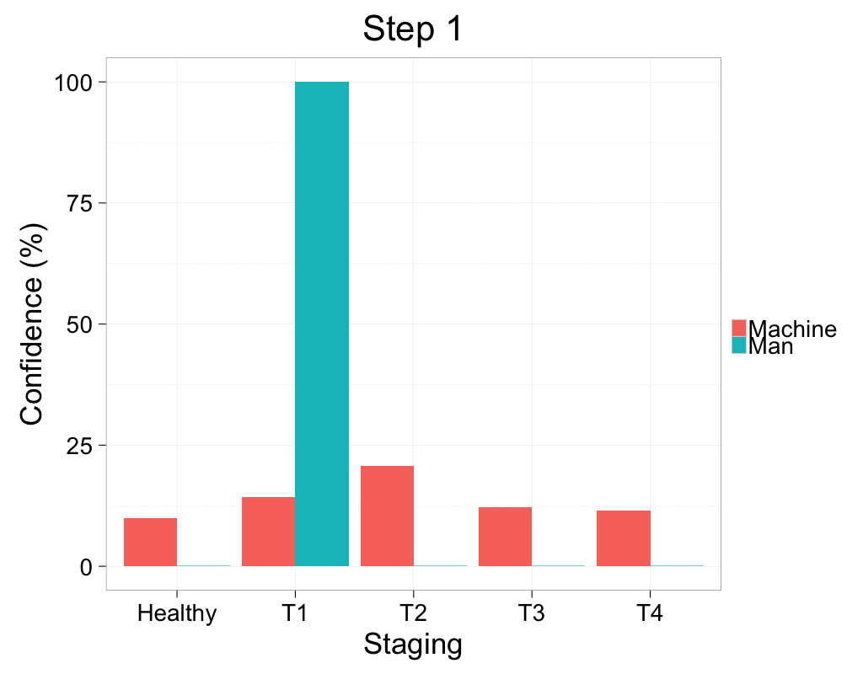
Examining thousands of images causes the performance of the staging to improve drastically
Training with thousands of images

Slide 16
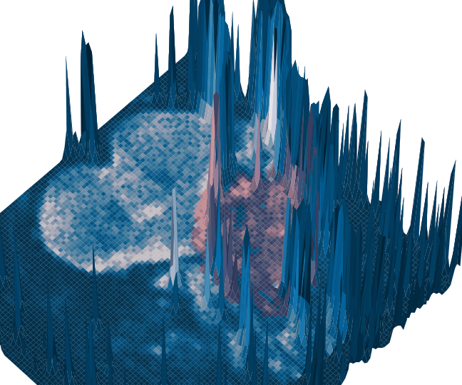
Go through each patient and update the system so the guess matches the physician identified tumor better
Learn patterns of pixels and signals that make up features
Patterns of features that make up tumors
Showing Attention of a Network

Slide 17
Finding and measuring features → very strong for computer
Tumor Volume (R² = 0.96)
Making diagnoses and staging → room for improvement
45% staged correctly
> 90% staged within 1
NASOPHARYNGEAL CANCER: MAN vs MACHINE
Staging | Percentage
Under-staged 1 | 25.76
Correct 0 | 45.45
Over-staged 1 | 21.21
Over-staged 2 | 7.58
Improving Reading of T2 MRIs through Deep Learning, K. Mader, RSNA 2016 (Accepted)

Slide 18
HOW TO DETECT CANCER?
Extensive training
with lots of data
and Deep Learning

Slide 19
CONCLUSION
Current technology is ready for radiology but:
Blackbox nature of AI and data acquisition pose serious challenges (RSNA 2017?)

Slide 20
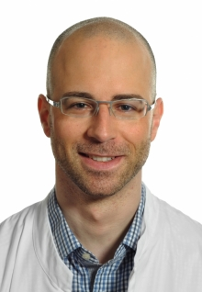
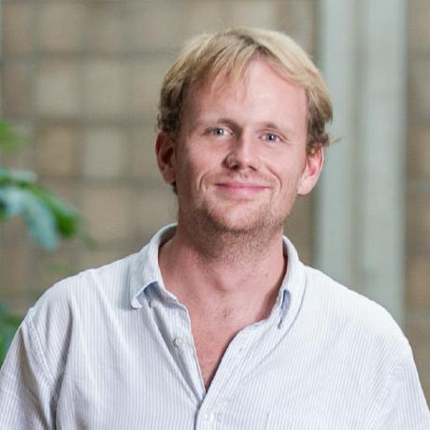

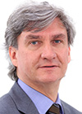
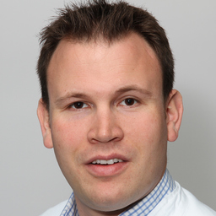
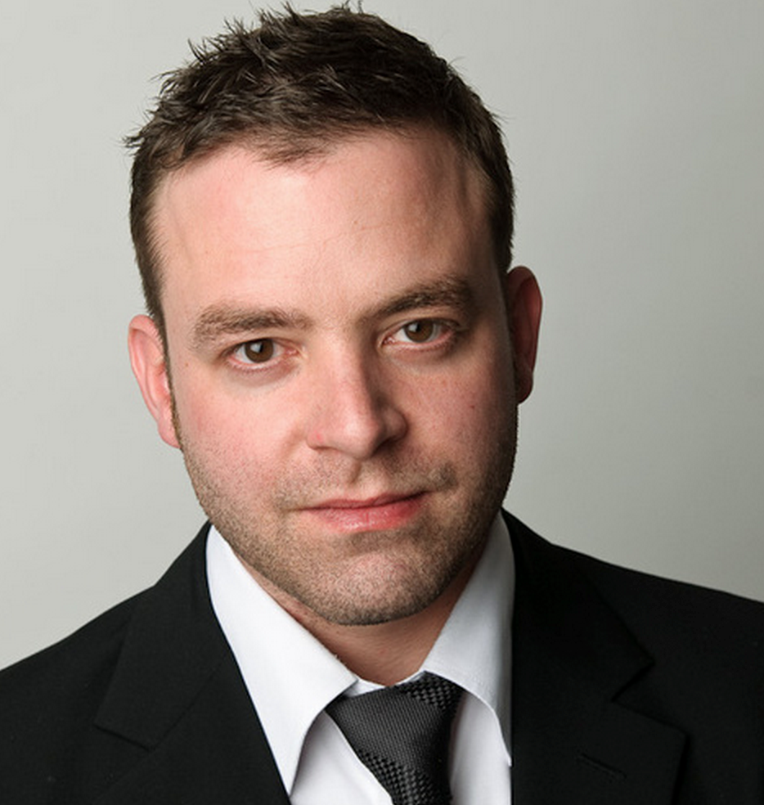

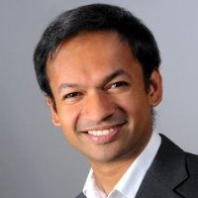

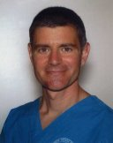

PD Dr. Tobias Heye
Oberarzt und stv. Leiter Kardiale und Thorakale Diagnostik
Dr. Kevin Mader
Doctor of Sciences ETHZ
Machine Learning / Image Analysis
Joachim Hagger
Master of Science in Physics
Digital business leader
Prof. Dr. Elmar M. Merkle
Chefarzt und Leiter Klinik für Radiologie und Nuklearmedizin
PD Dr. Alexander Sauter
Facharzt Radiologie, Assistenzarzt Nuklearmedizin
Flavio Trolese
Dipl. Ing. FH Informatik
Digital business leader
Bram Stieltjes, MD, PhD
Forschungsgruppenleiter Radiologie
Joshy Cyriac
Machine Learning / Software Engineering
Dr. med. Dipl. Phys. Gregor Sommer
Stv. Oberarzt Cardiale und Thorakale Diagnostik
Dr. Thomas J Re, MD, MSEE
Research, Software Engineering
4Quant BIG IMAGE ANALYTICS
Notes:
thomas re, joachim, flavio, joshy

Slide 21
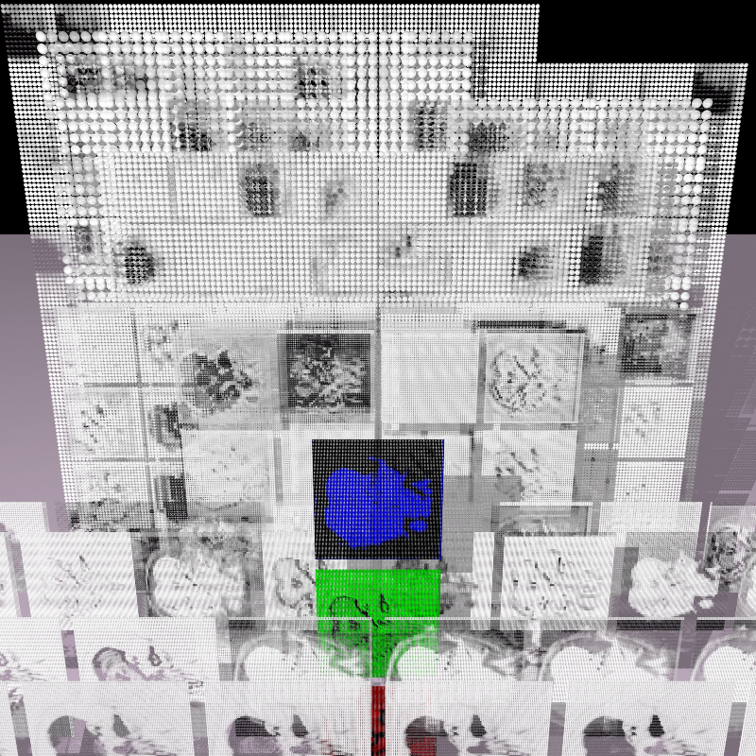
Thanks for your attention!
Read More
https://medium.com/@4quant
Code More
github.com/4quant
Get in touch
info@4quant.com,
bram.stieltjes@usb.ch

